Slide 1
Satellite/Aerial Image Retrieval
Zhiquan Li
Date: Apr/04/2018

Slide 2

Outlines :
1.
Background and Introduction
2.
Problem Analysis
3.
Proposed Solution
4.
Algorithm Implementation
5.
Conclusions and Findings

Slide 3
Background and Introduction
Nowadays, the quality and amount of aerial image has increased rapidly with the development of satellite image sensor, which brings great opportunities for the development of content-based aerial image retrieval, like HD map, GPS navigation system and so on.
The Bing Maps of Microsoft provides an API for aerial image retrieval, users could use this API to manipulate to pan and zoom directly, and it also provide the introduction document of the tile system and source code to help users to understand the system deeper.
Therefore, the requirements of this assignment is complete based on Bing Map Tile System.

Slide 4
Problem Analysis
The problem is to retrieve the aerial images by given two different pairs of latitude and longitude. And it also needs to retrieve multiple tiles to fill the bonding box with max resolution. The retrieval procedure could use the document of tile system^{[1]} provided by Bing Maps, which is to do a serial of conversion by giving coordinates.

Slide 5
Proposed solution
For the problem, we could convert map coordinate of latitude and longitude to coordinates in pixel and to convert the pixel coordinates to tile coordinates, then, we could use the tile coordinates to generate quadkey to retrieve its corresponding aerial image. Finally, we could stitch these images to get the requested result.
There is a problem mentioned by Bing Maps, which is there is no aerial image in some specific level of detail and specific places. For this problem, we could check each tile and decrease the level of detail to make each aerial image is available.

Slide 6
Algorithm Implementation
Step1. Define the maximum level of detail according to map coordinates, which is to get json response from Bing Maps API, and check if the current image is null. If it is null, we decrease the level of detail and get the json response again until the image is not null. Otherwise, move to setp2.
Step2. The Bing Maps already provides source code to do conversion among different coordinate system. So we could use the LatLongToPixelXY method to get the pixel coordinates according to the given map coordinates and level of detial.
Step3. Convert pixel coordinates to tile coordinates by using given method PixelXYToTileXY

Slide 7
Algorithm Implementation
Step4. Create empty image with the same size of the bonding box according to given two pixel coordinates. This image is for aerial image concatenation, which is our final result.
Step5. Retrieve aerial images iteratively by using each tile coordinates in the bonding box and add them to the empty image created in step4.
Step6. Save the result image when all aerial images have been stitched together.

Slide 8
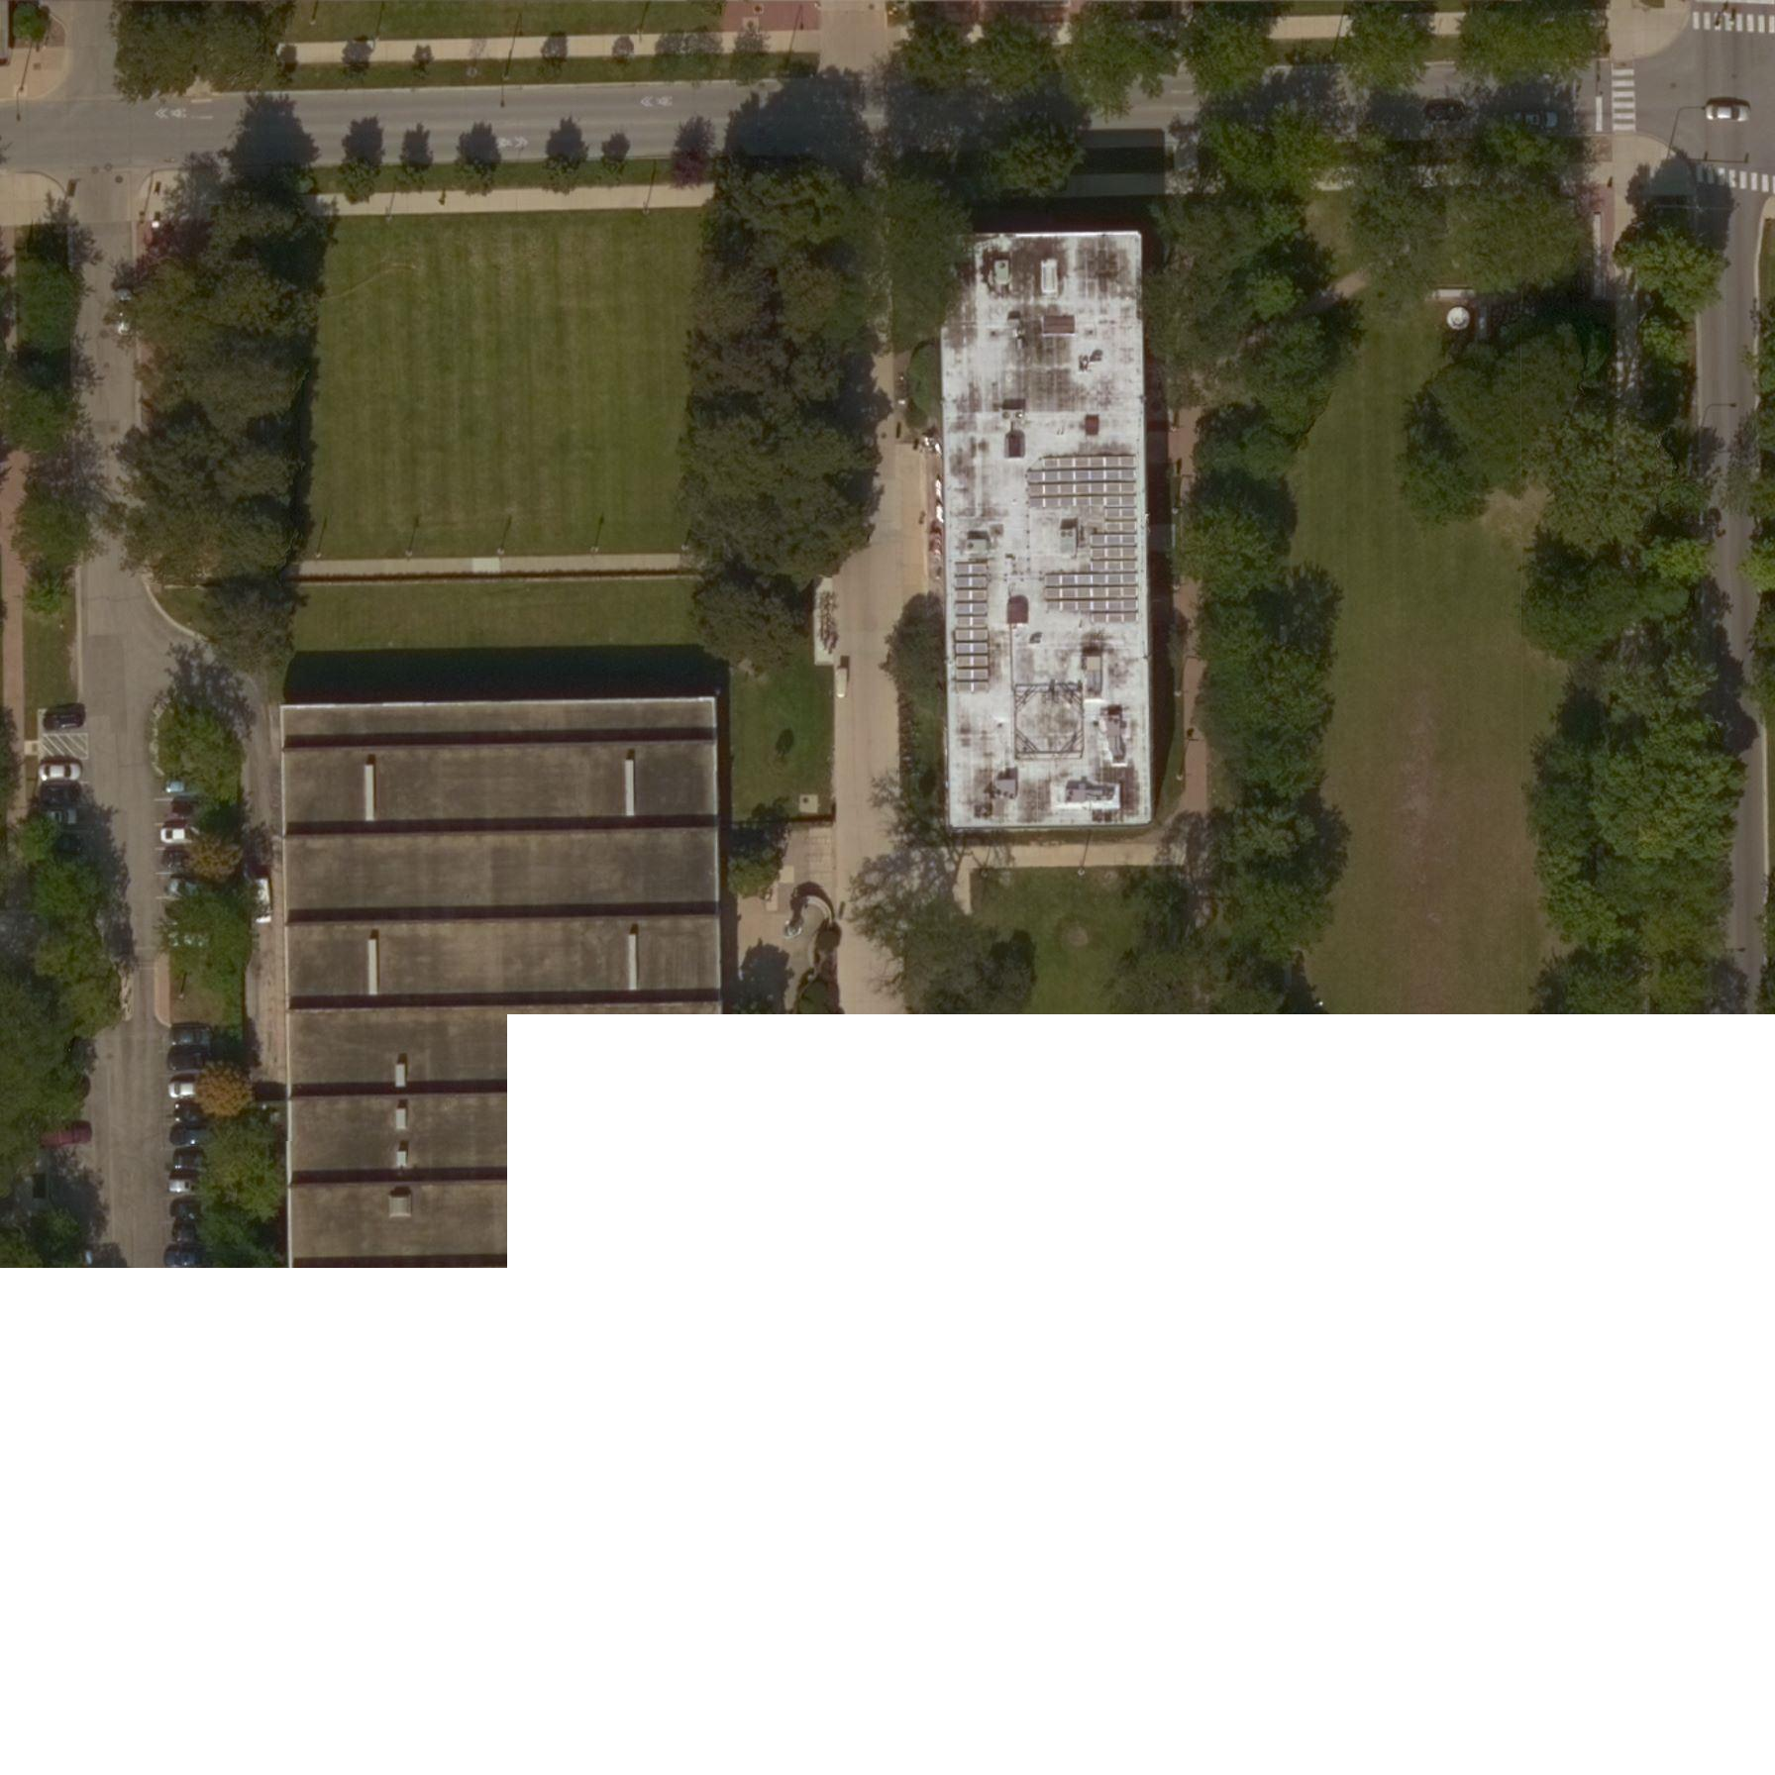
Algorithm Implementation
Result:
This partial result is to show how the image concatenation works. Each retrieved aerial image is 256 X 256 with the maximum resolution.
Partial result of step5

Slide 9
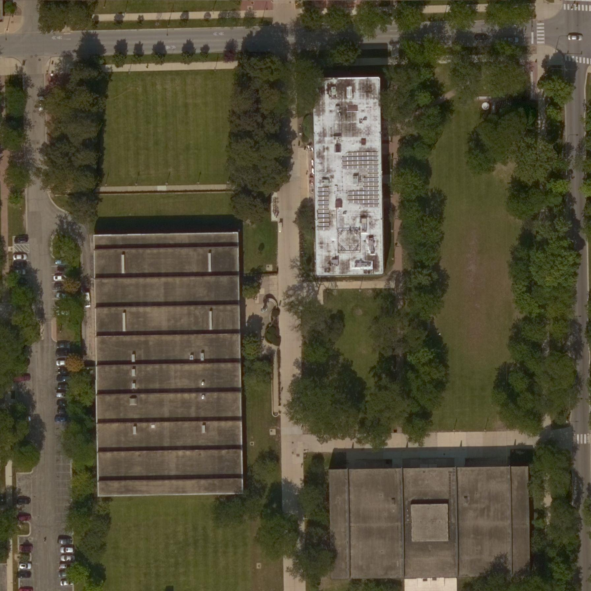
Algorithm Implementation
Result:
This is the final result of IIT Paul V. Galvin Library, the two corresponding map coordinates are (41.834594, -87.628887) and (41.832947, -87.626451)
IIT Paul V. Galvin Library area

Slide 10
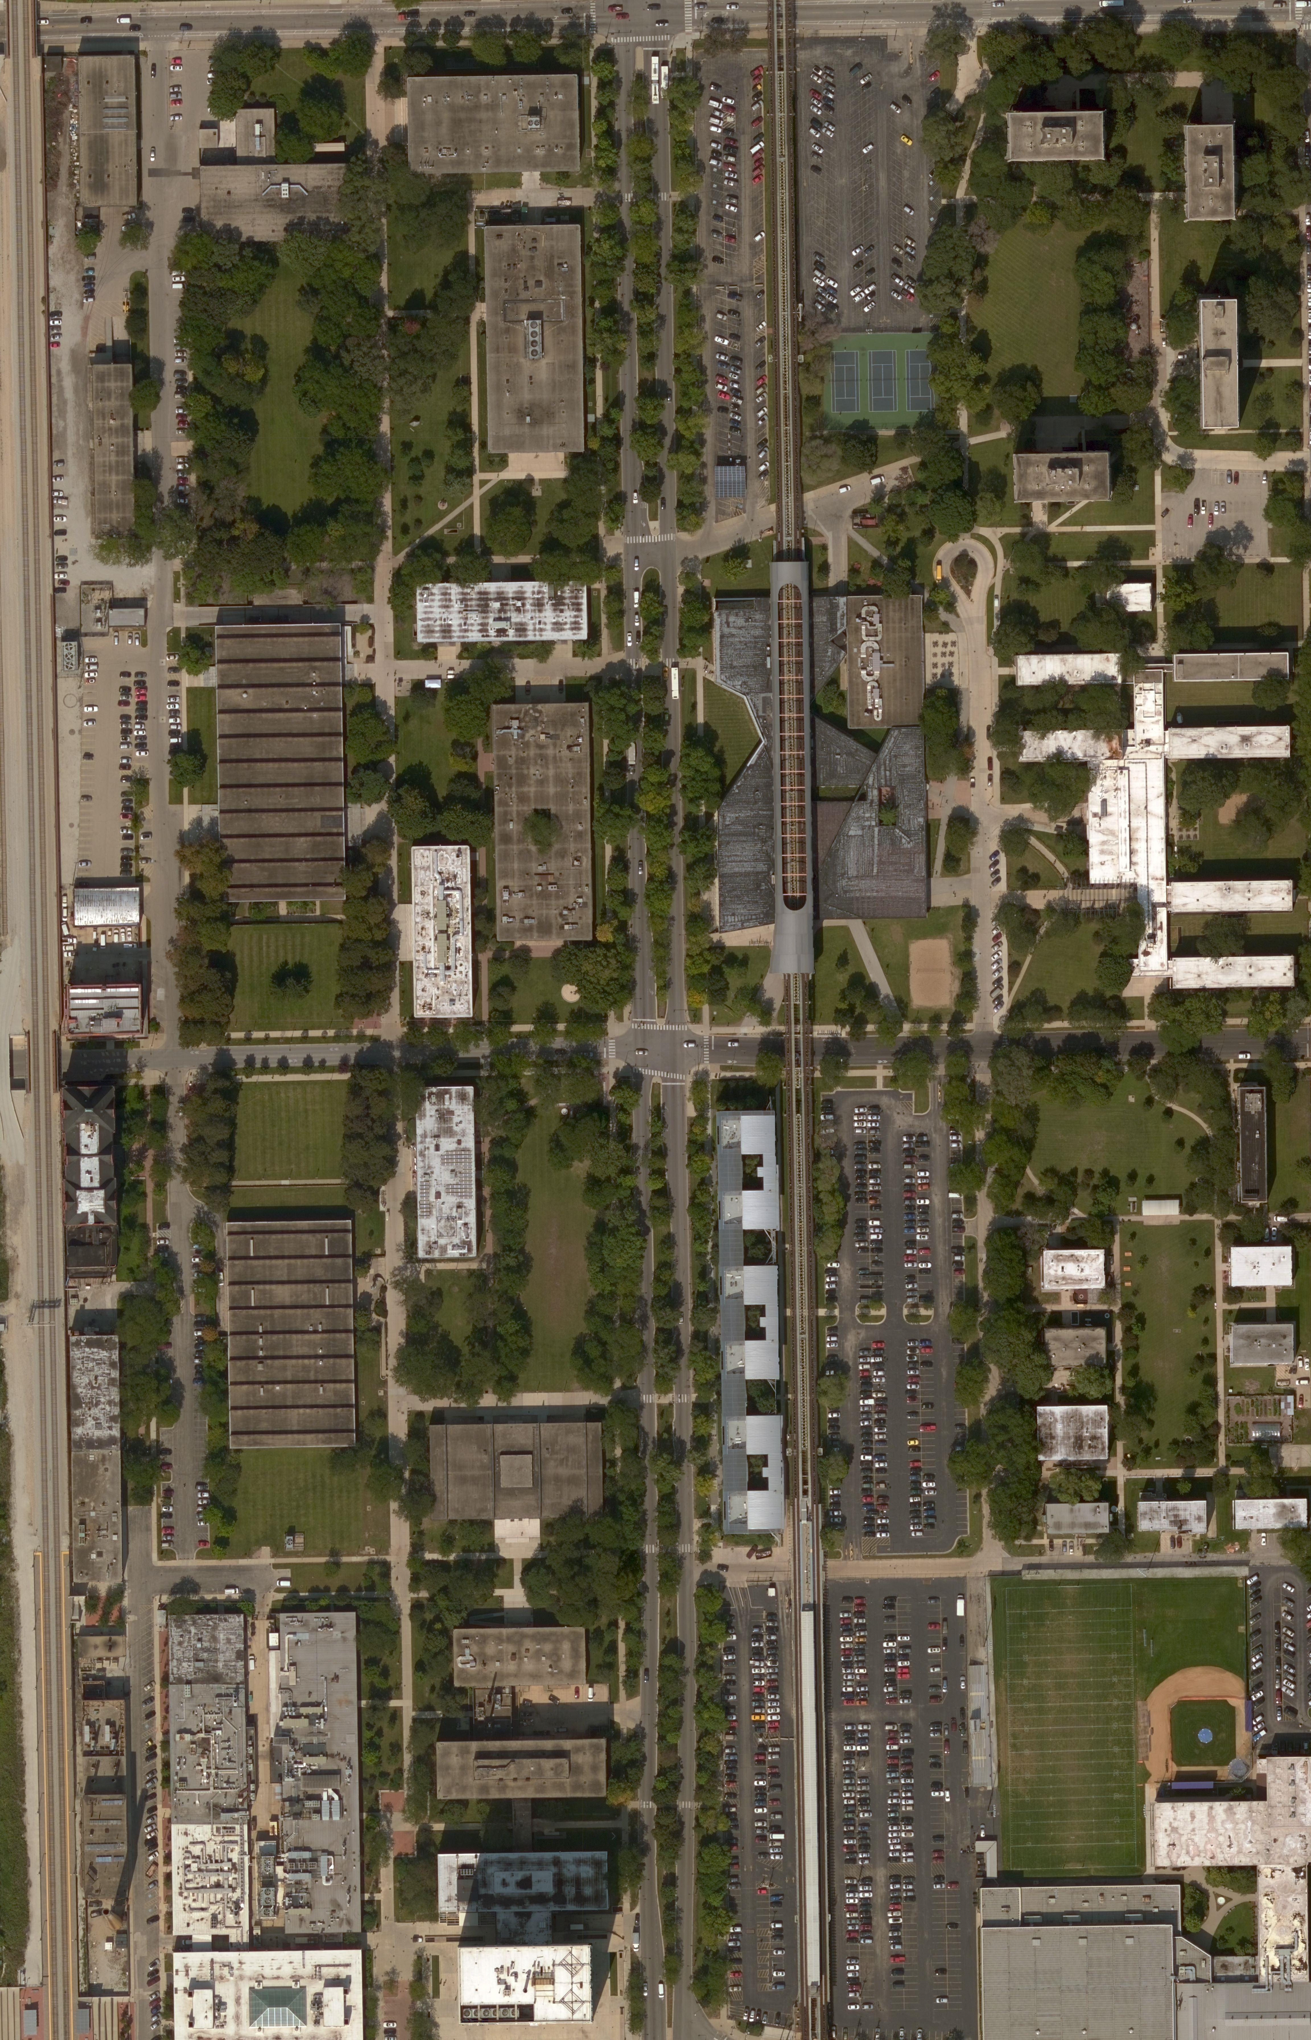
Algorithm Implementation
Result:
This is the final result of IIT campus, the two corresponding map coordinates are (41.838250, -87.629586) and (41.831085, -87.623237)
IIT campus

Slide 11
Conclusion and Findings
The whole solution is based on Bing Maps’ API and coordinate system conversion. The performance is good. However, the size of final image is corresponding to the distance of two given map coordinates since we retrieve aerial image with maximum resolution, which means the longer distance of two map coordinates will cause larger size of image. For this problem, we could modulate the level of detail according to distance of two map coordinates to get best resolution for giving bond box, not the maximum resolution.

Slide 12
Reference
1. Bing Maps Tile System, https://msdn.microsoft.com/en-us/library/bb259689.aspx

